Slide 1
Introduction to GitHub
BMI 719

Slide 2
GitHub - Learning Goals
What is a version control system?
What is a typical Git workflow?
What can I do with branches?

Slide 3
Version Control Systems
Track changes to documents
typically: software source code
also: documentation, scientific manuscripts, homework assignments, etc.
Allow retrieval of earlier versions
Ensure integrity of your documents

Slide 4
Version Control Systems
Manage multiple alternative states (“branches”)
Enable collaborative work
Can provide a backup of your documents
Time

Slide 5
GitHub Workflow
initialize repository on GitHub
“clone” repository to local computer
edit files
stage changes (all or selectively)
commit changes to local repository (often)
sync with remote repository (as needed)
*
Notes:
https://github.com/ to login

Slide 6
Github Prerequisites
Method of interacting with github
Github desktop
( https://desktop.github.com/ )
or
Command line
( https://git-scm.com/book/id/v2/Getting-Started-Installing-Git )
Internet access!

Slide 7
GitHub Workflow
initialize repository on GitHub
“clone” repository to local computer
edit files
stage changes (all or selectively)
commit changes to local repository (often)
sync with remote repository (as needed)
*
Notes:
https://github.com/ to login

Slide 8
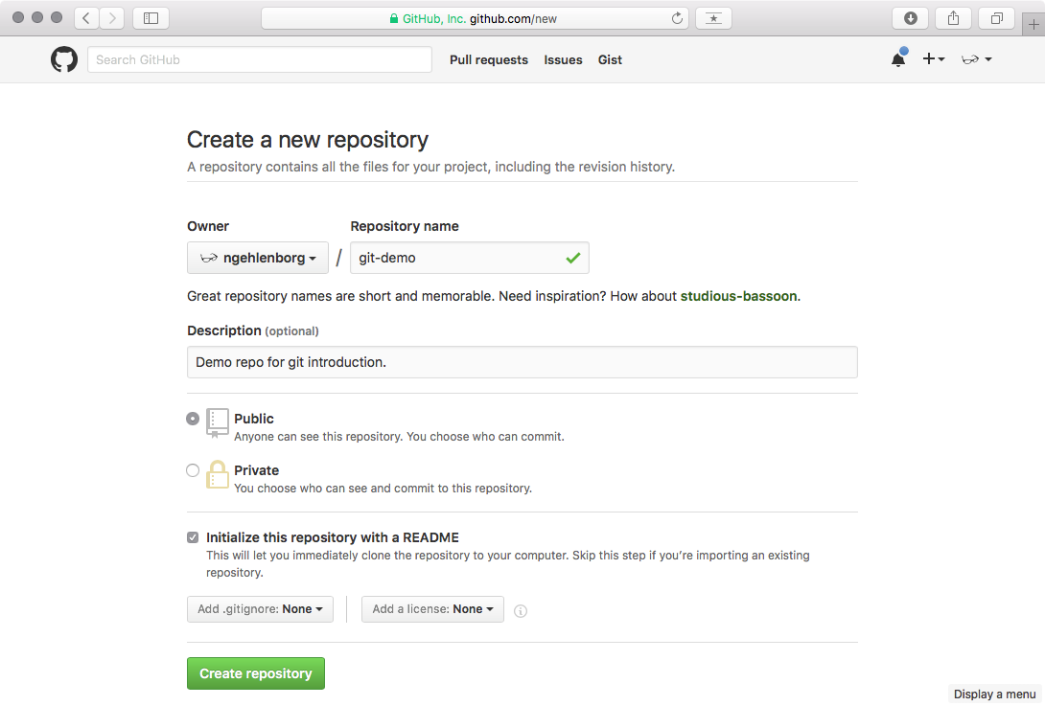
Workflow: Initialize Repo
*

Slide 9
Try it: Initialize Repo
Log into github.com
New Repository > Initialize “bmi719-lab1” repo
*

Slide 10
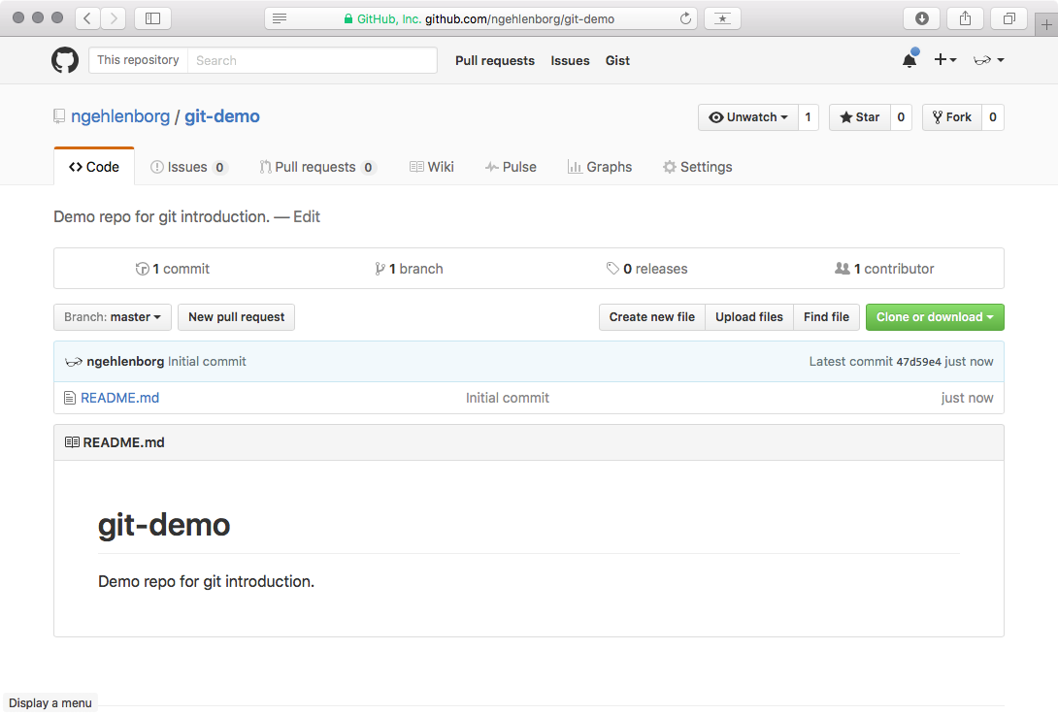
Workflow: Initialize Repo
*

Slide 11
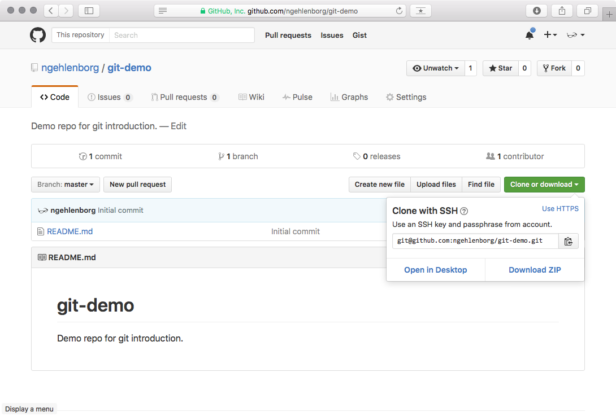
Workflow: Clone Repo
*

Slide 12
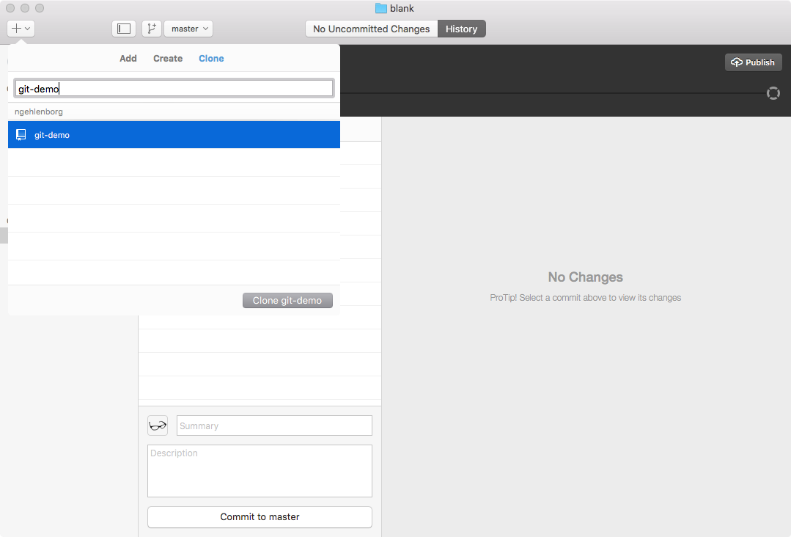
Workflow: Clone Repo
*

Slide 13
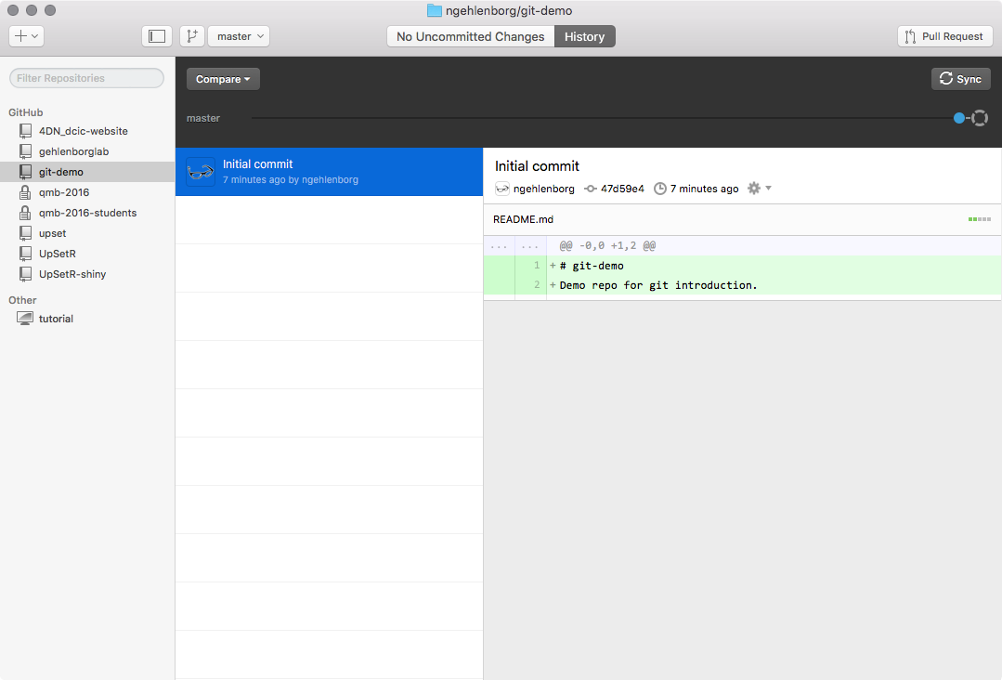
Workflow: Clone Repo
*

Slide 14
Try it: Clone Repo
Open github desktop
File > clone repository
Input the clone URL
Input file location
Press clone!
*

Slide 15
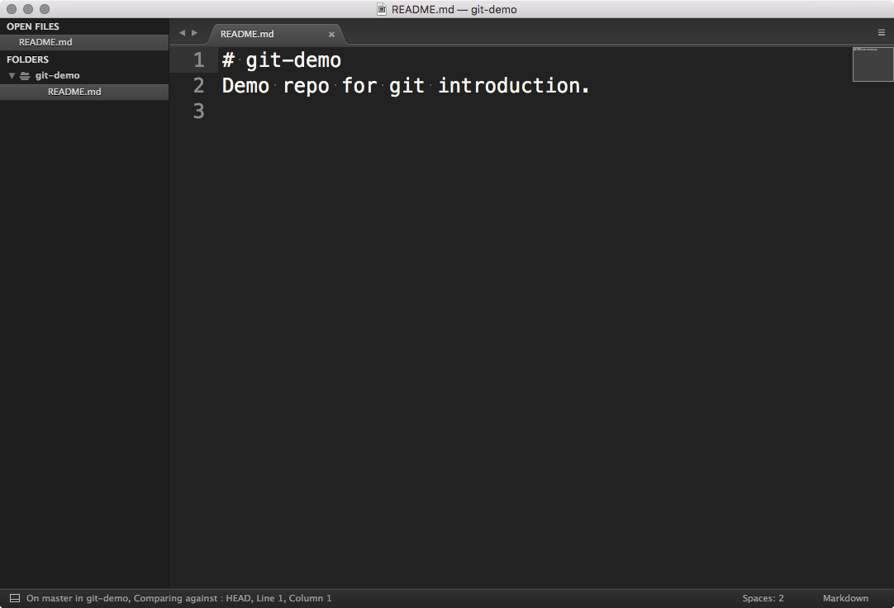
Workflow: Edit Files
*

Slide 16
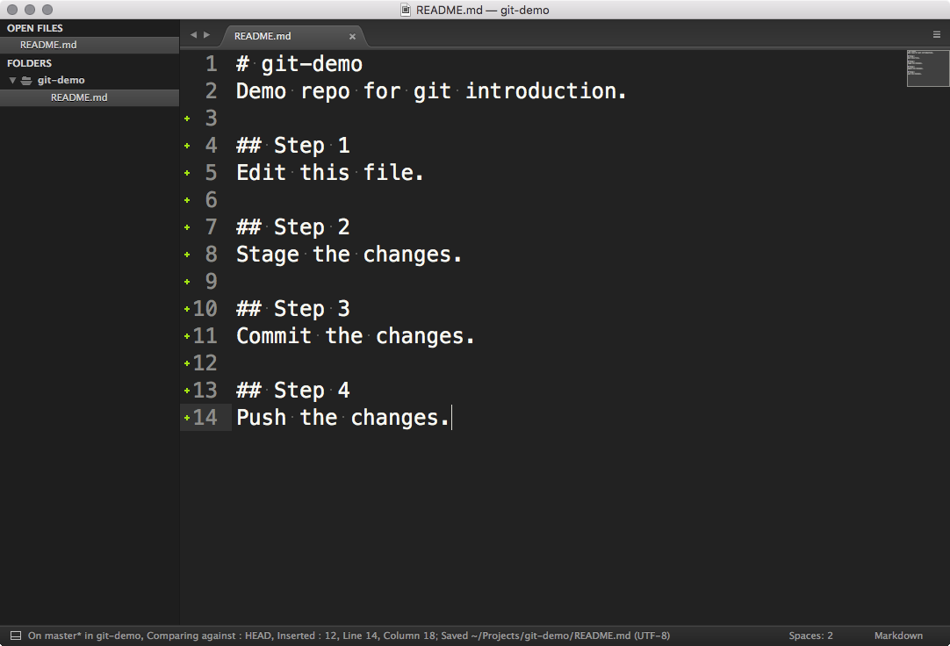
Workflow: Edit Files
*

Slide 17
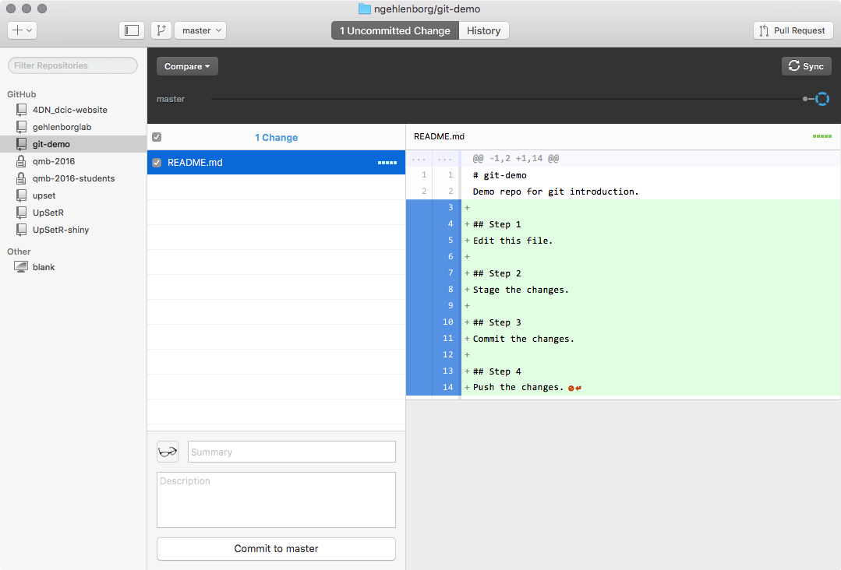
Workflow: Edit Files
*
Notes:
View edits here

Slide 18
Try it: Edit Files
Create and edit a file inside your repo
View changes on github desktop
*

Slide 19
Workflow: Stage and Commit
*

Slide 20
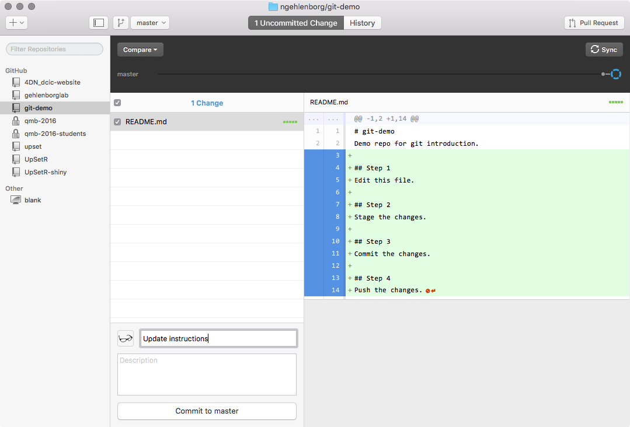
Workflow: Stage and Commit
*

Slide 21
Workflow: Stage and Commit
Two things just happened:
File was added to the staging area: git add README.md
Staged files were committed to the local repository: git commit -m “message”

Slide 22
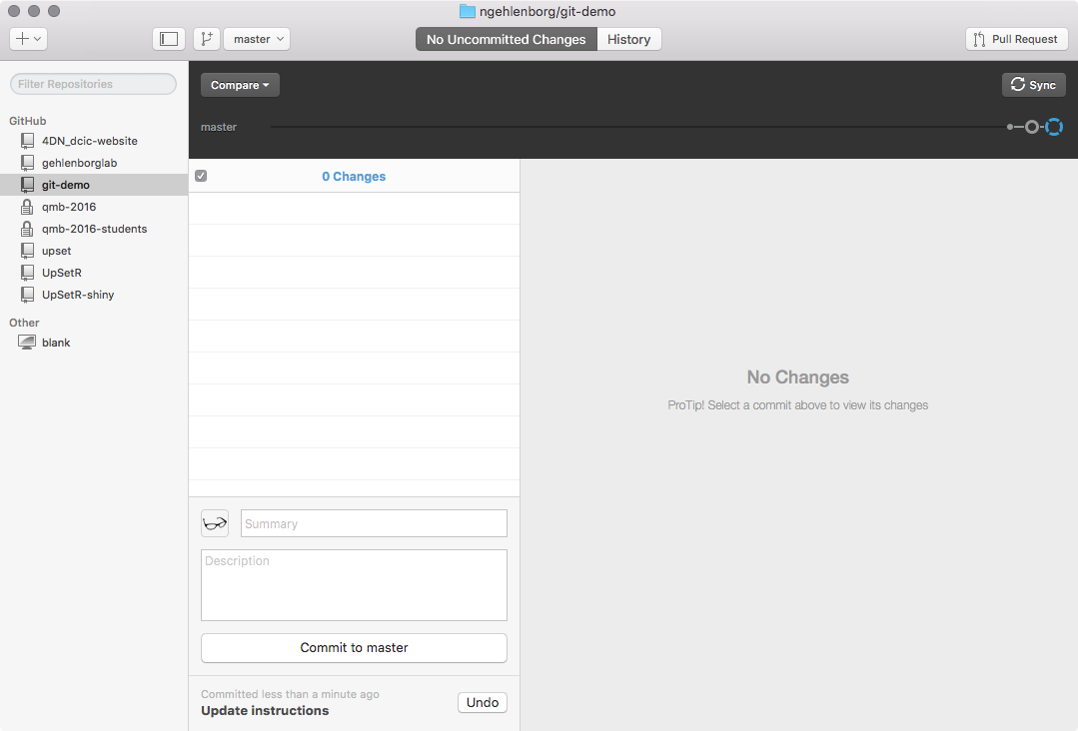
Workflow: Stage and Commit
*
Notes:
Push happened

Slide 23
Try it: Stage and Commit
On Github desktop:
Specify files to commit
Input a summary
Commit
Sync/push
*

Slide 24
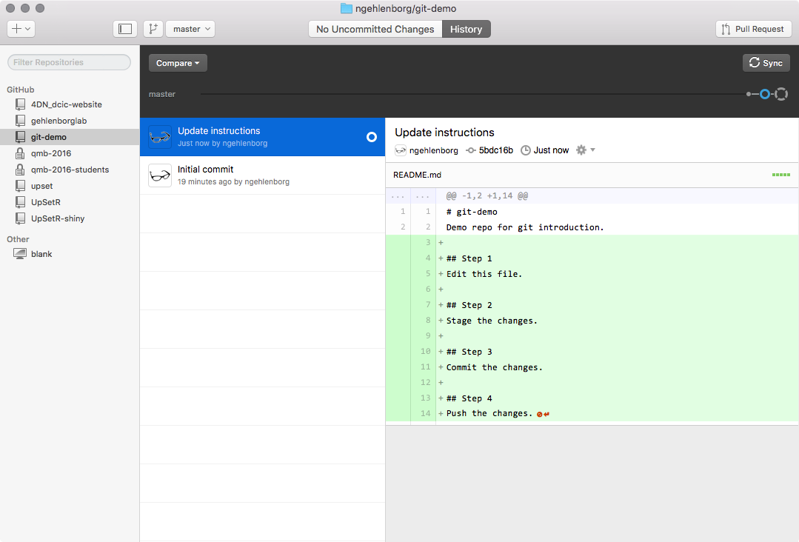
Workflow: Stage and Commit
*
Notes:
View changes in commit

Slide 25
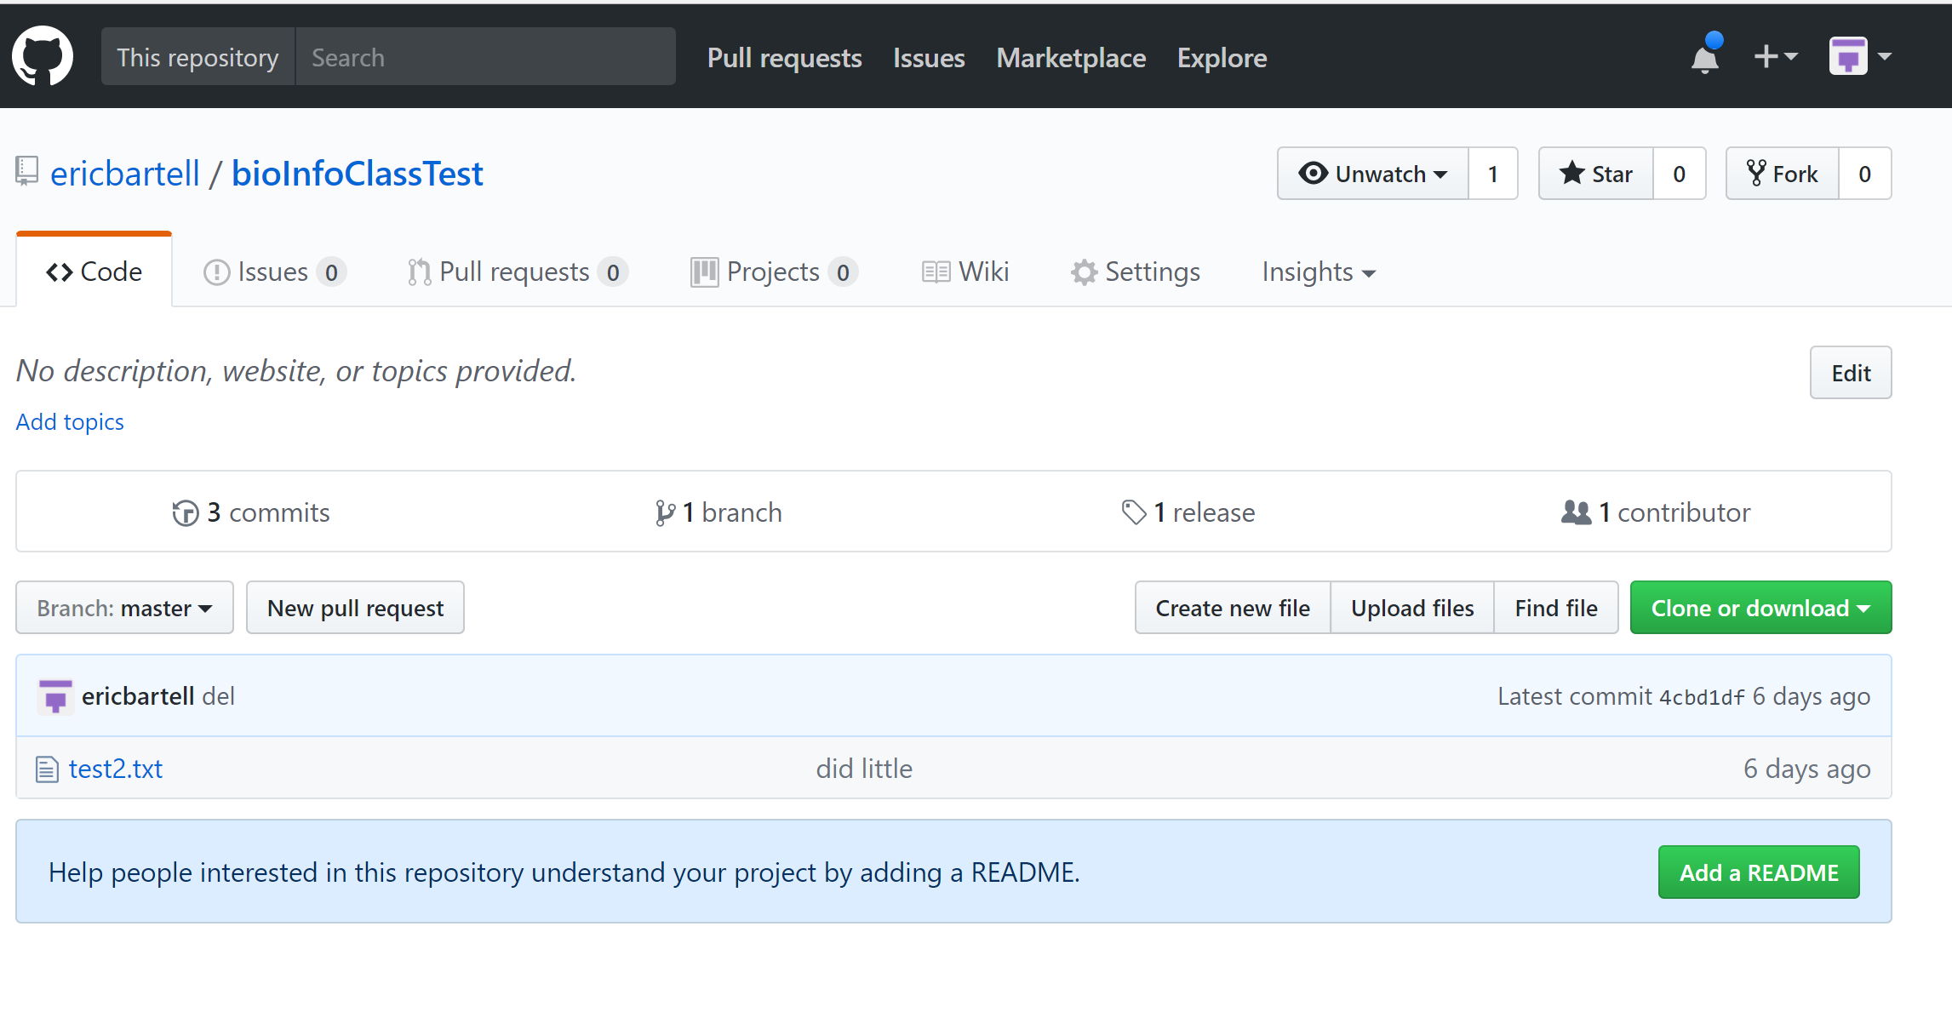
Workflow: Tagging a Commit
*

Slide 26
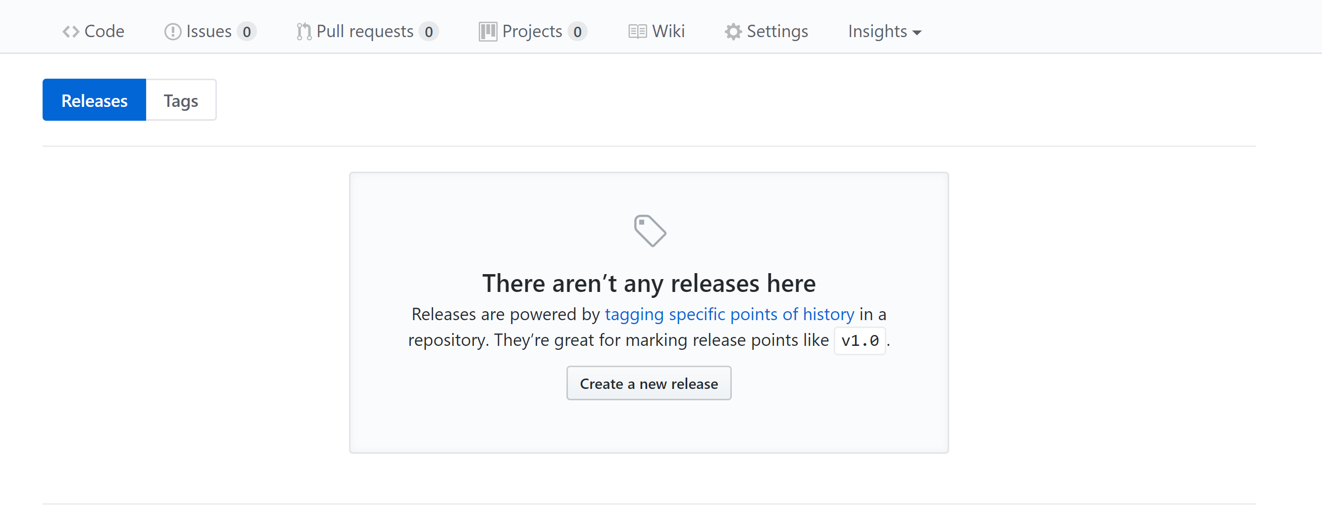
Workflow: Tagging a Commit
*

Slide 27
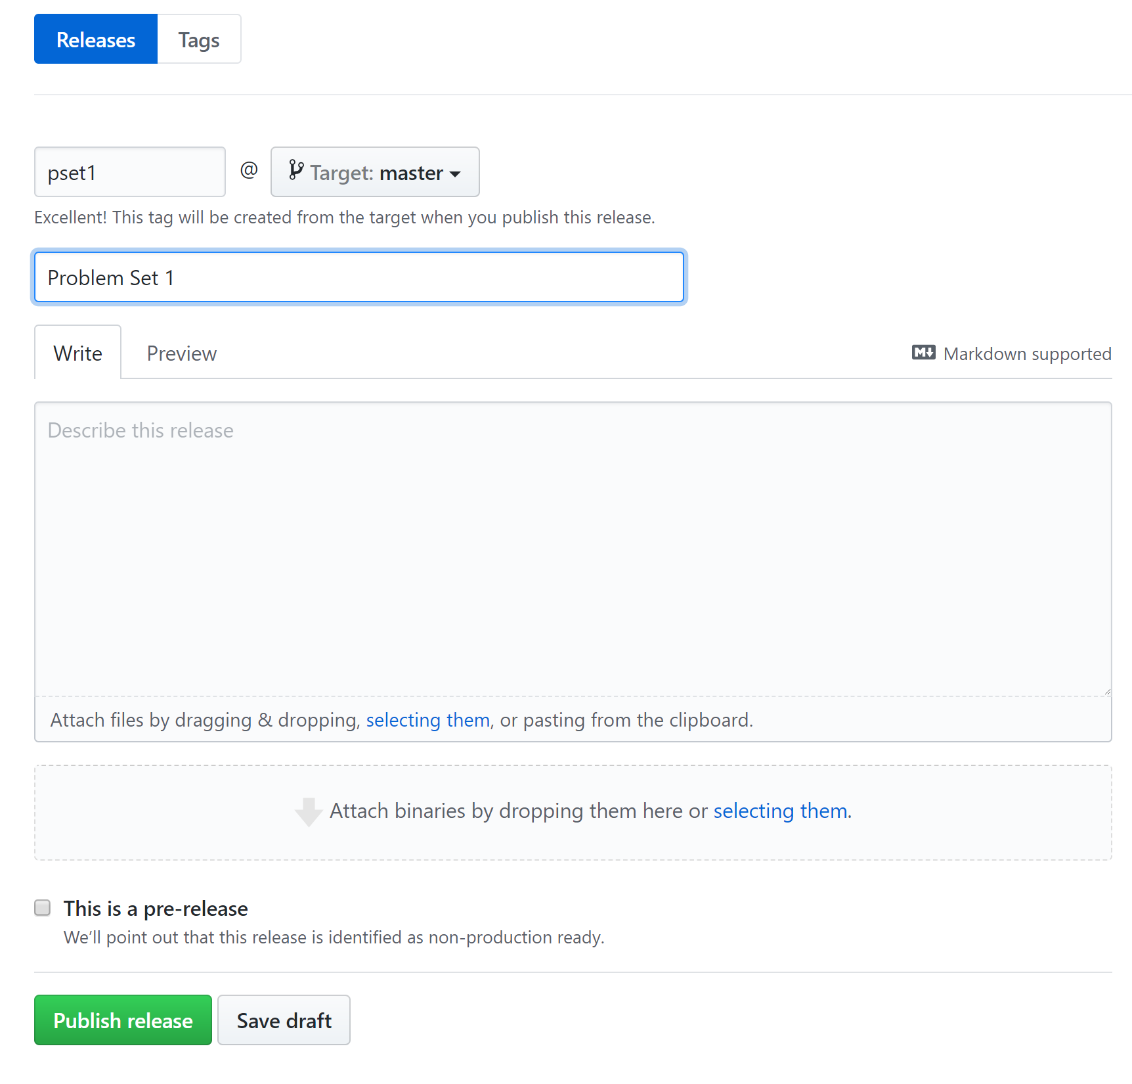
Workflow: Tagging a Commit
*

Slide 28
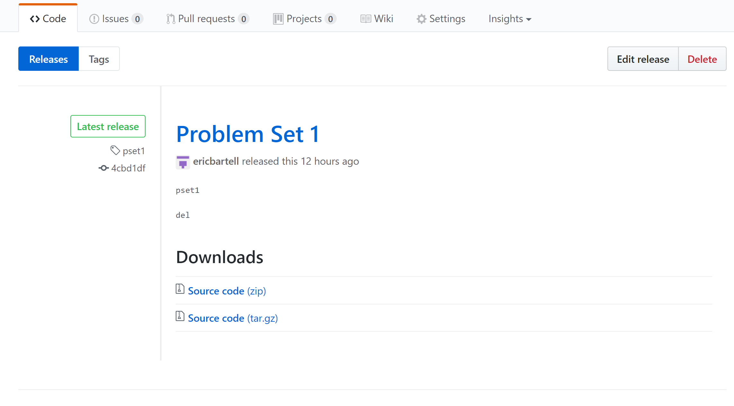
Workflow: Tagging a Commit
*
Ngehlenborg released this 10 hours ago

Slide 29
Try it: Tagging a Commit
On Github browser:
Repo > releases > create a new release
Tag and title
Publish
*

Slide 30
Workflow: Branching
Branching is useful for a number of things, for example:
Working on alternative solutions to a problem
Adding new features that require lots of changes
Your directory will always show only the code for the currently selected branch!

Slide 31
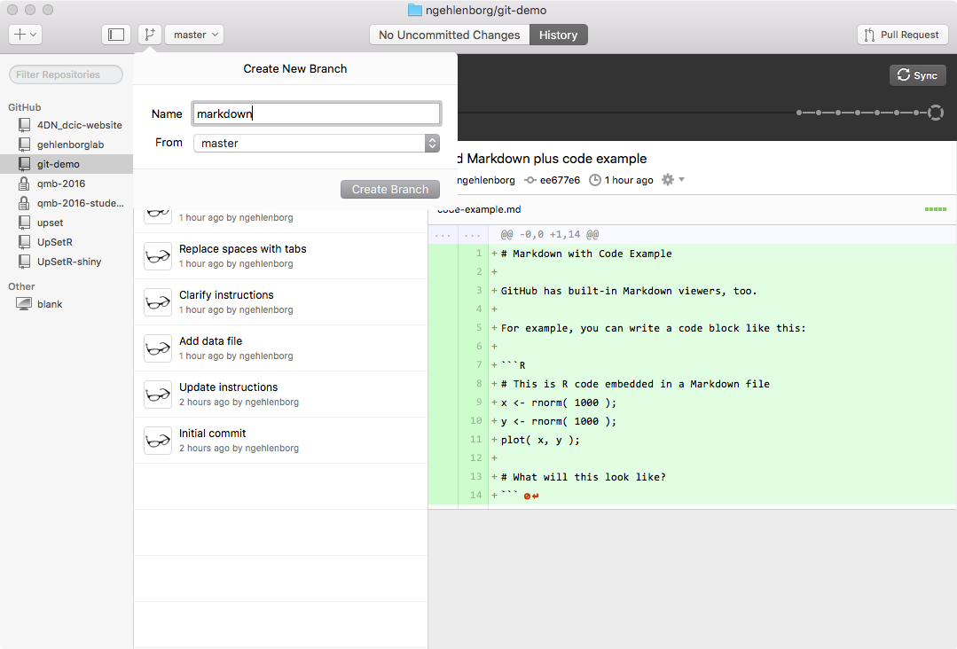
Workflow: Create Branch
*

Slide 32
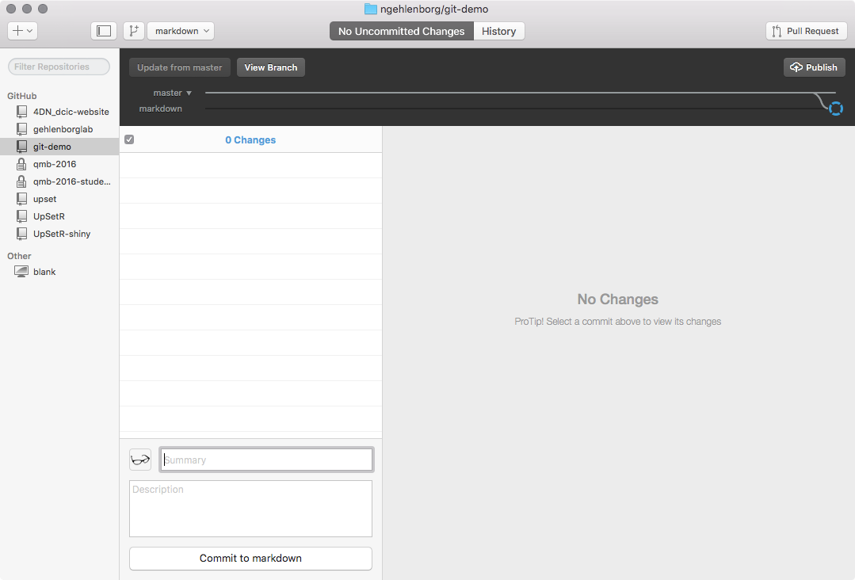
Workflow: Create Branch
*

Slide 33
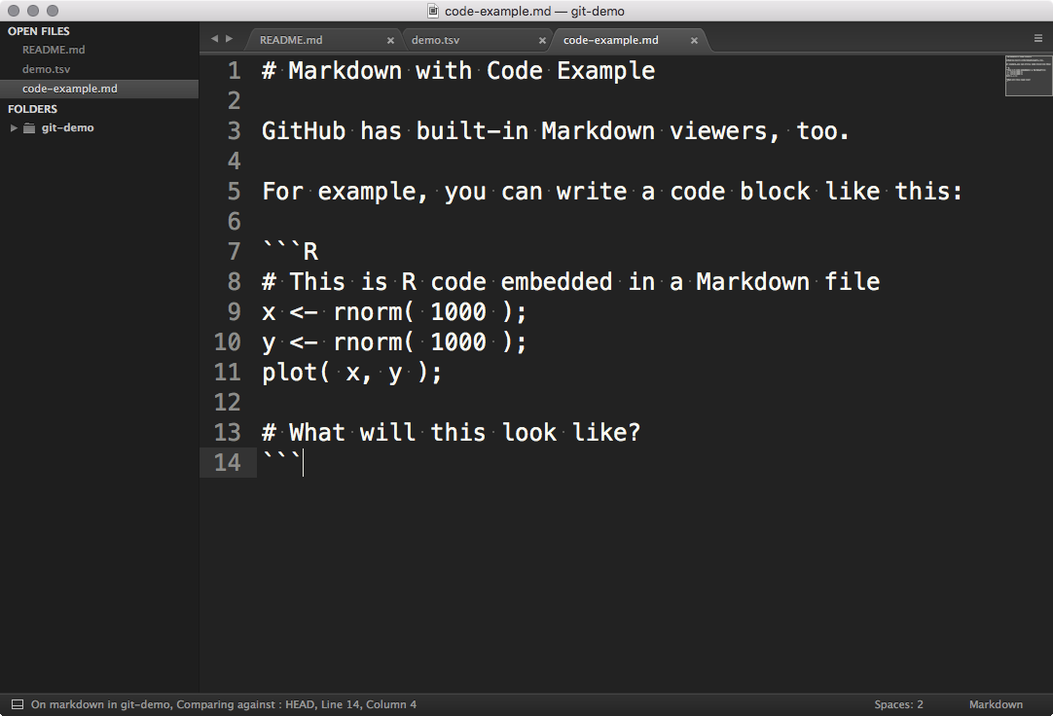
Workflow: Edit Branch
*

Slide 34
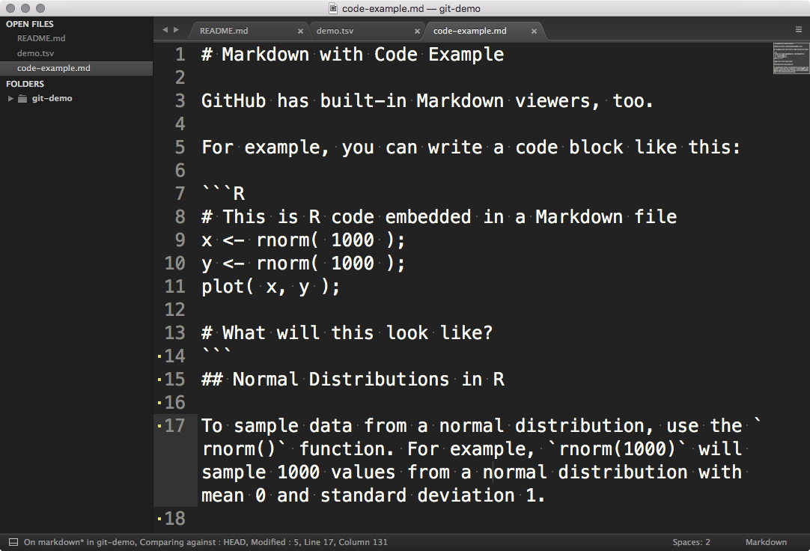
Workflow: Edit Branch
*

Slide 35
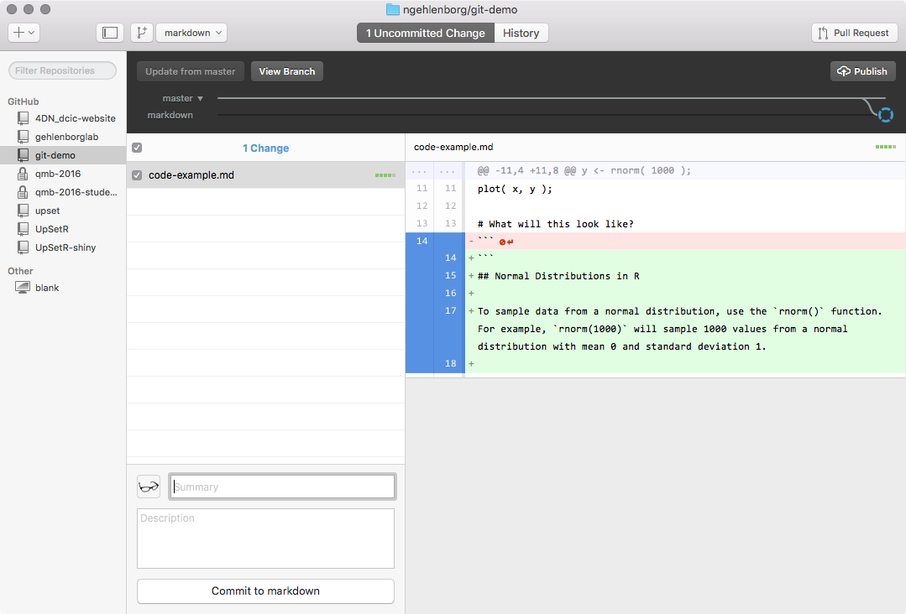
Workflow: Stage and Commit
*

Slide 36
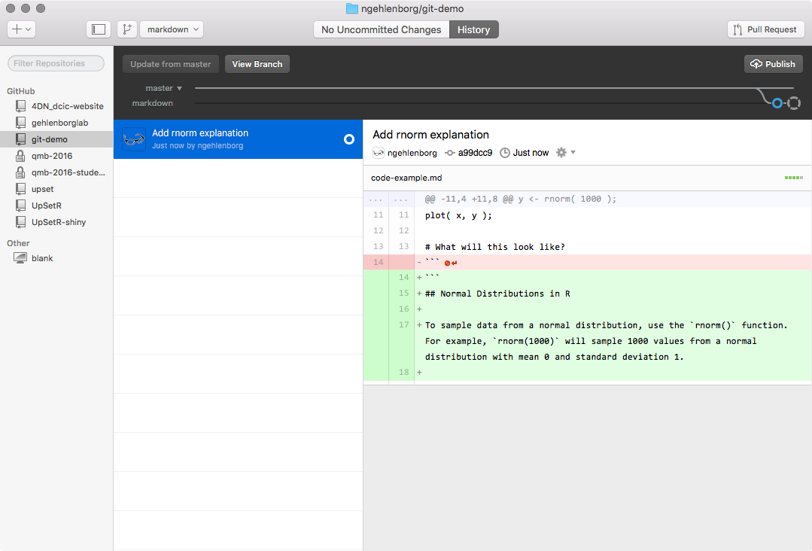
Workflow: Stage and Commit
*

Slide 37
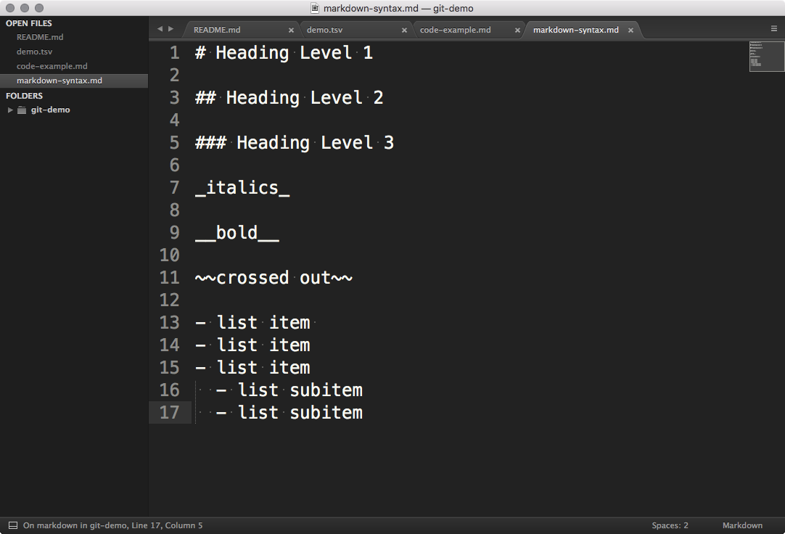
Workflow: Add File
*

Slide 38
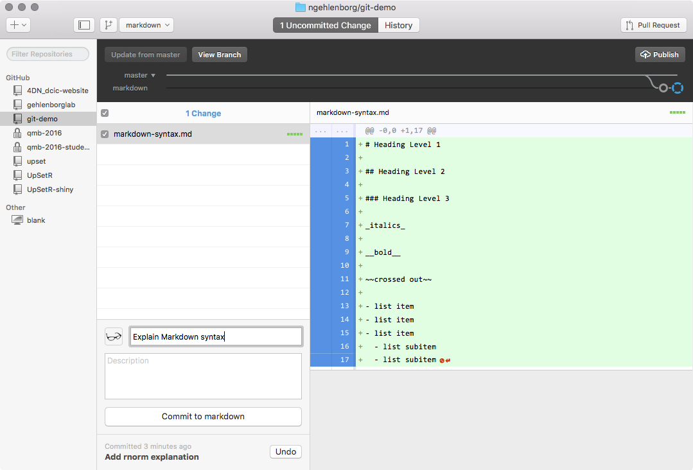
Workflow: Stage and Commit
*

Slide 39
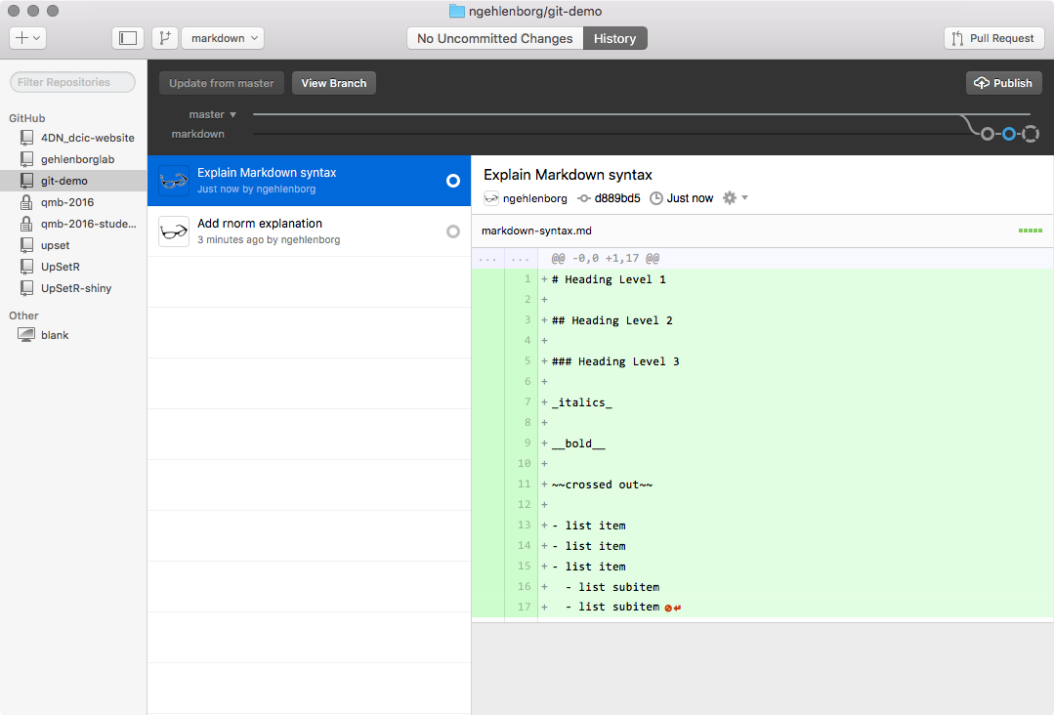
Workflow: Publish Branch
*

Slide 40
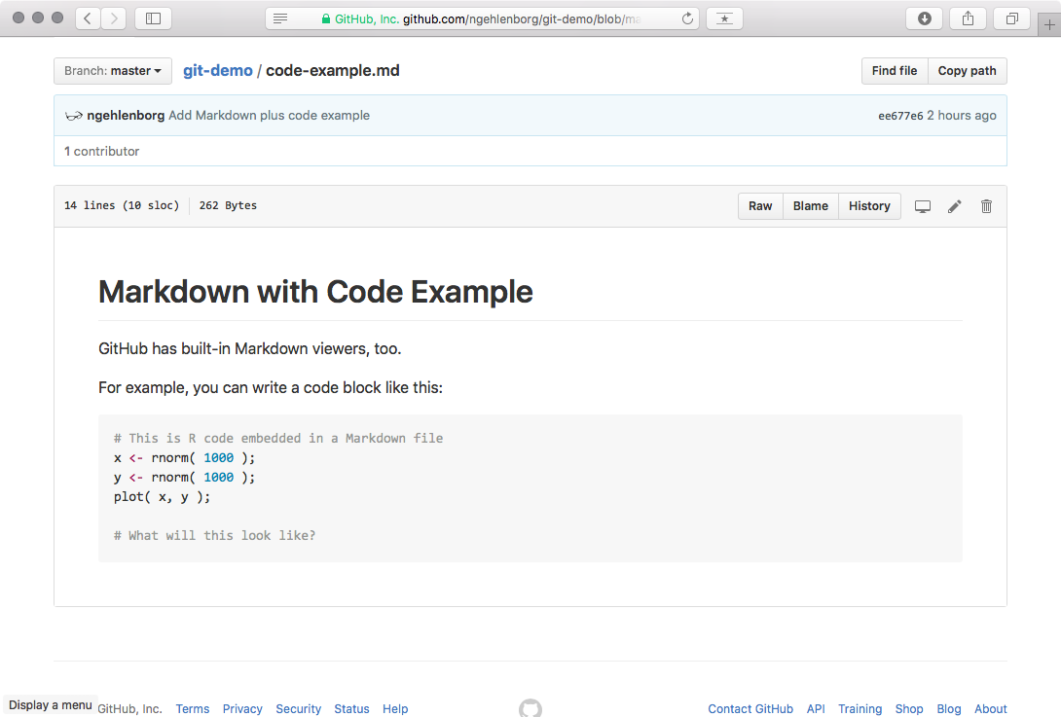
Workflow: View Branch (GitHub)
*

Slide 41
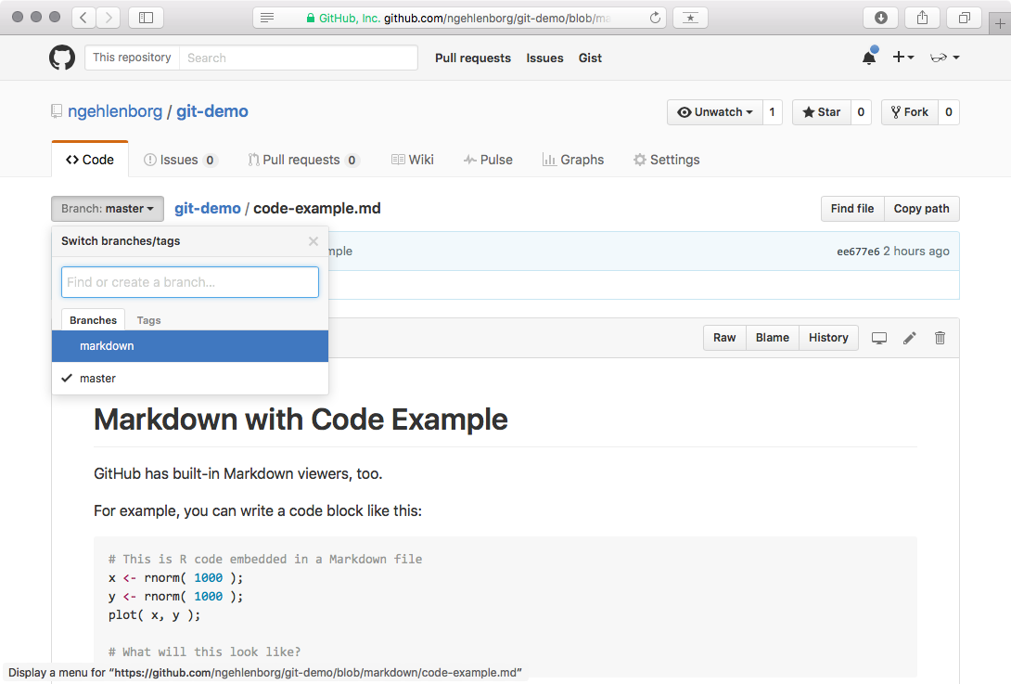
Workflow: View Branch (GitHub)
*

Slide 42
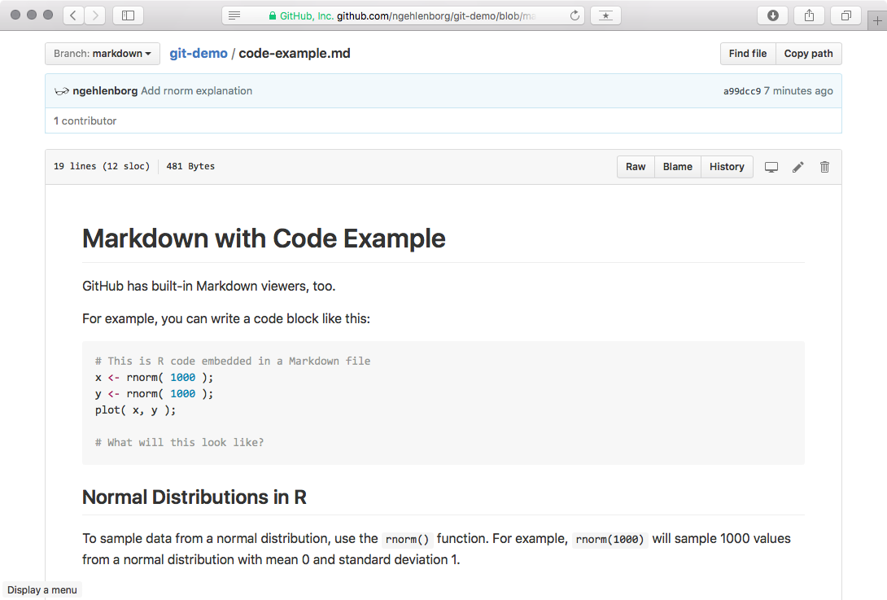
Workflow: View Branch (GitHub)
*

Slide 43
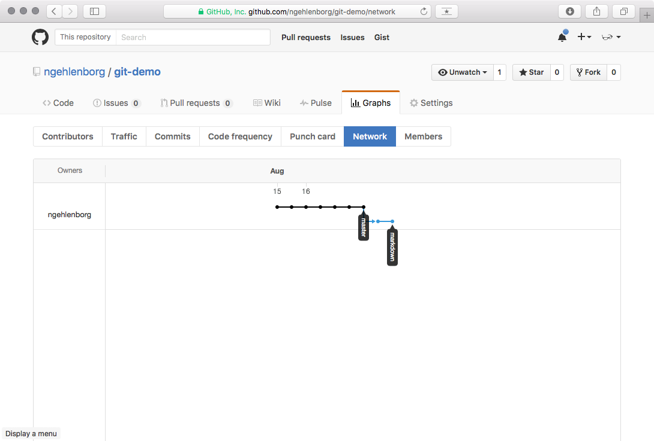
Workflow: View Branch (GitHub)
*

Slide 44
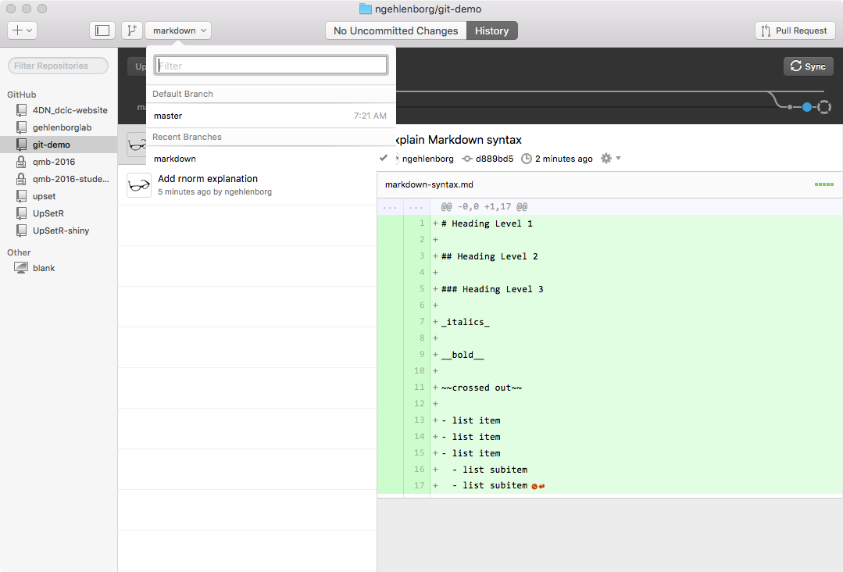
Workflow: Merge Branches
*

Slide 45
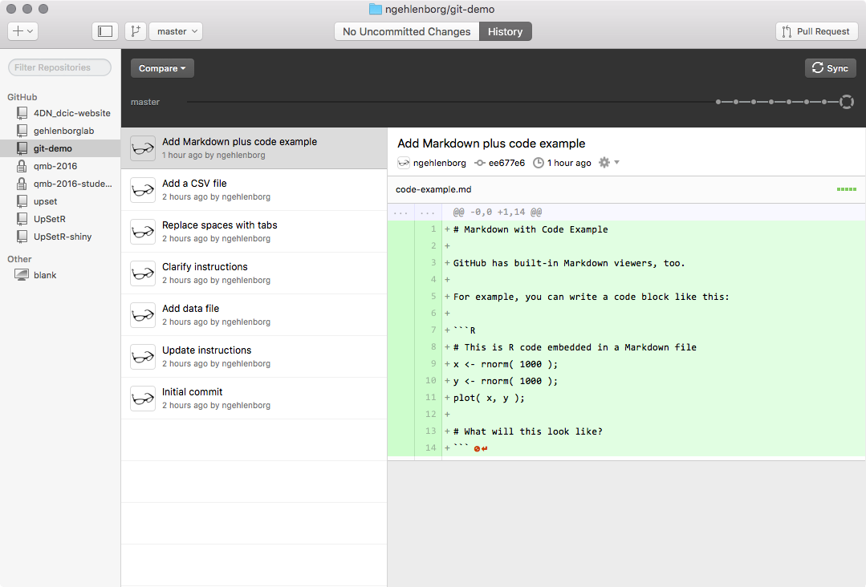
Workflow: Merge Branches
*

Slide 46
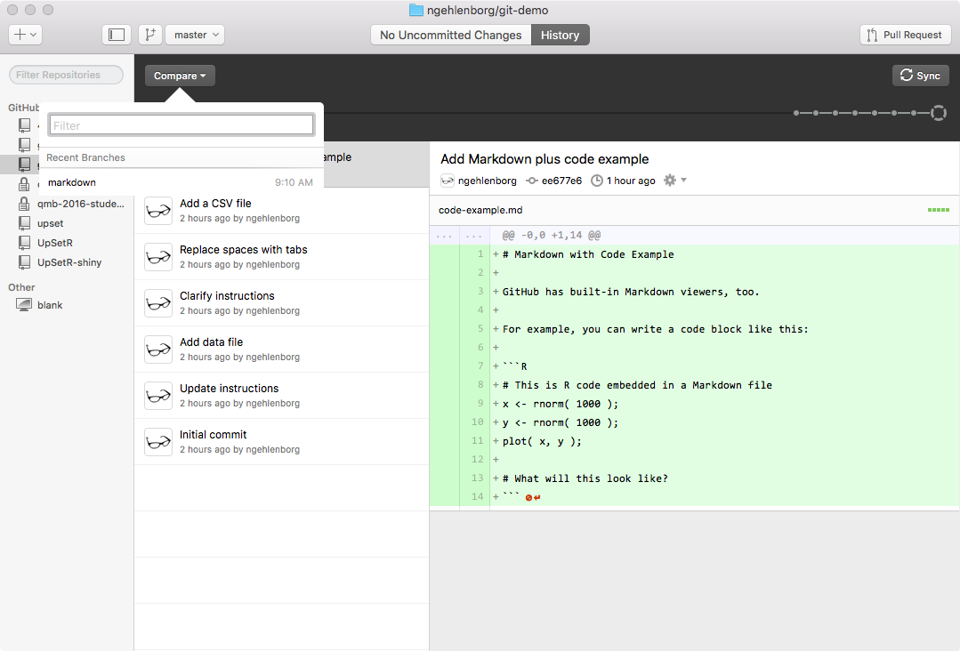
Workflow: Merge Branches
*

Slide 47
Workflow: Merge Branches
*

Slide 48
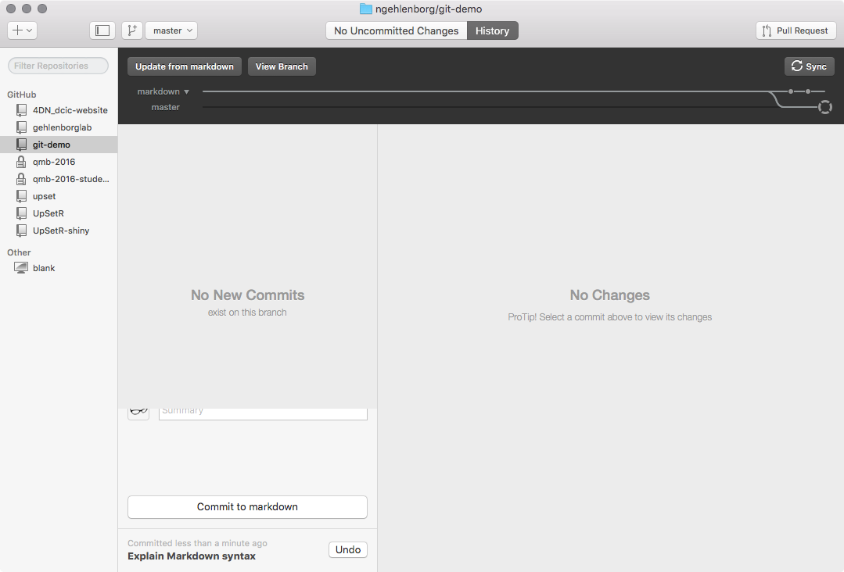
Workflow: Merge Branches
*

Slide 49
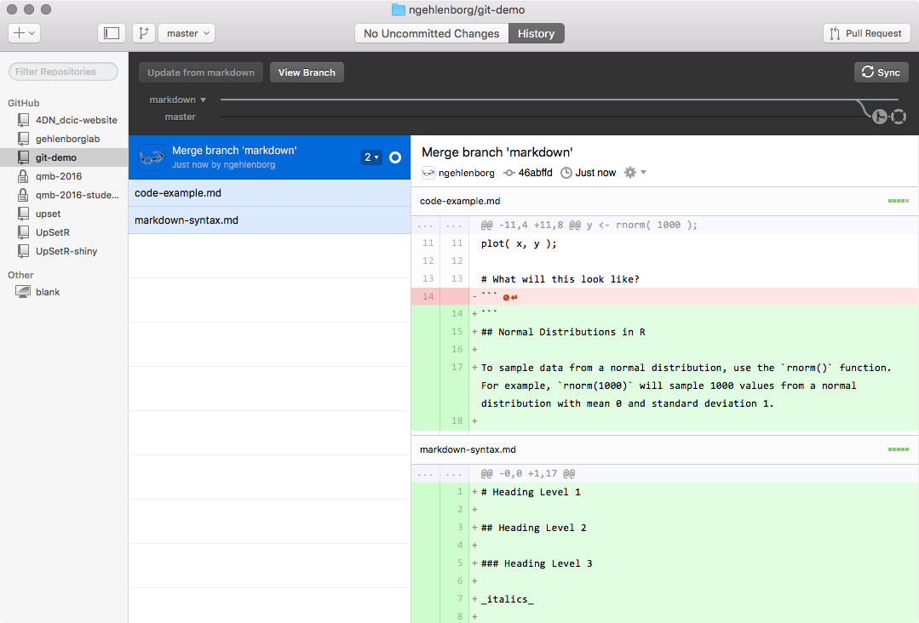
Workflow: Merge Branches
*

Slide 50
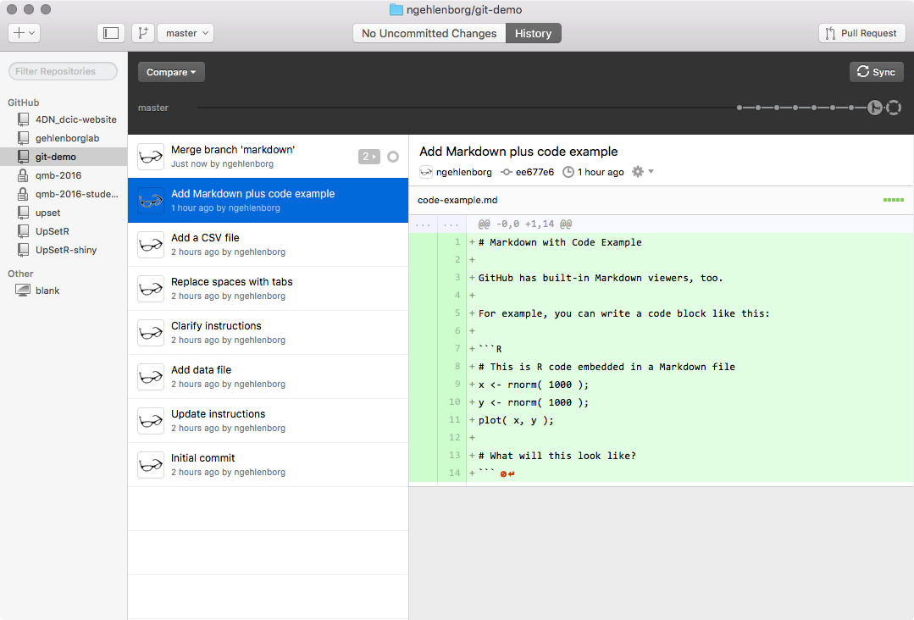
Workflow: Merge Branches
*

Slide 51
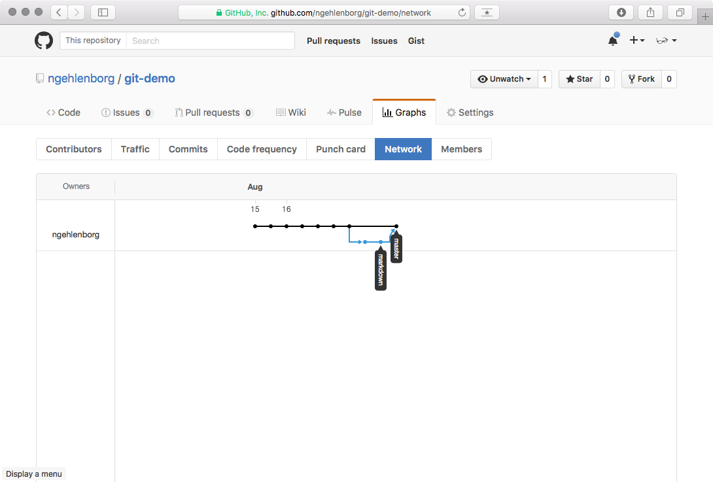
Workflow: Merge Branches
*

Slide 52
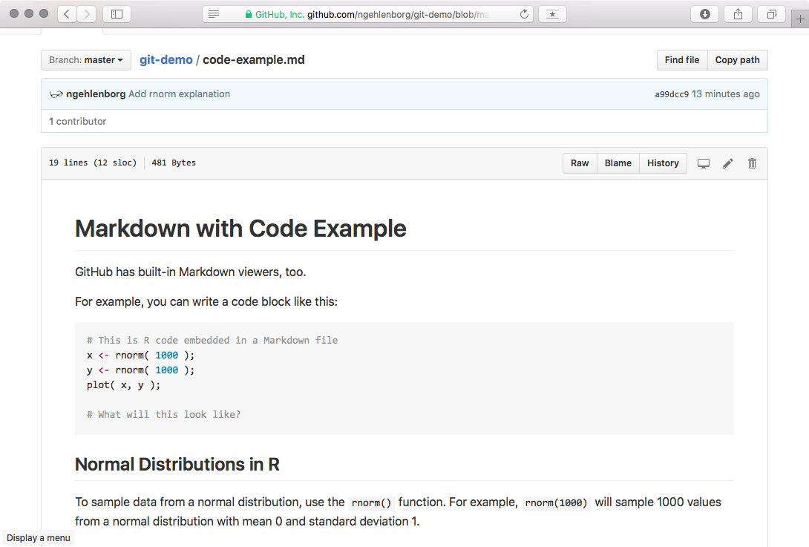
Workflow: Merge Branches
*

Slide 53
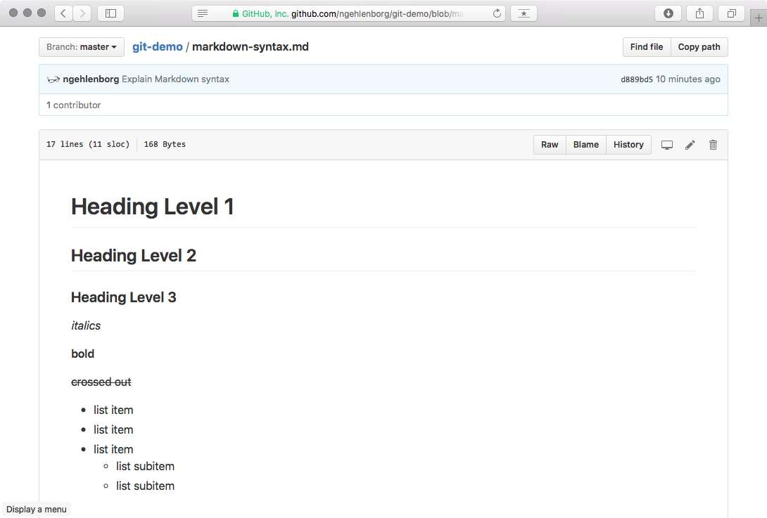
Workflow: Merge Branches
*

Slide 54
Workflow: Merge Branches
*

Slide 55
GitHub Features
Forking repos: create a copy of an existing repo
Can also be kept in sync with the original repo
Pull requests: notify repo owner that you have changes that can be merged
Permissions for users and teams via organizations
Issue Tracker

Slide 56
Acknowledgements
Github website (www.github.com) and github desktop
Nils Gehlenborg

